Slide 1
Introduction to AI - Heuristic Based Agents
Philip Mortimer

Slide 2
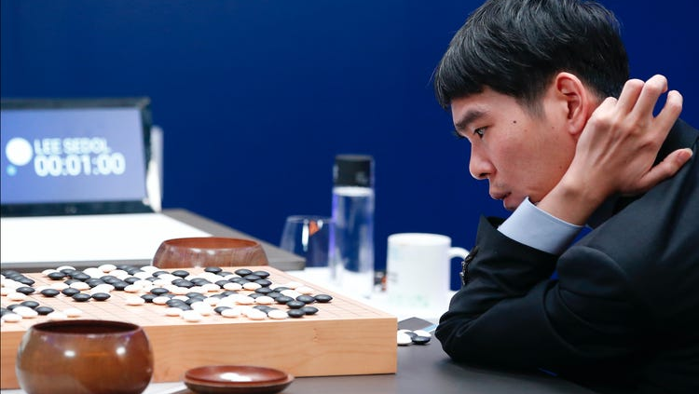
“Even if I become the No. 1, there is an entity that cannot be defeated” – Lee Sedol

Slide 3
Recap
Discussed how to solves mazes using depth first search
Introduced breadth first search as a way to solve mazes optimally
Looked at tree structures as a way to represent mazes
Dijkstra’s Algorithm
A* search
Degrees of separation

Slide 4
Tic Tac Toe
In Tic Tac Toe (also known as Noughts and Crosses!) two players take into in turn to either play a cross or a nought.
The first player to have a horizontal, vertical or diagonal line of one symbol wins.
If neither player manages a line, the game ends in a draw.

Slide 5
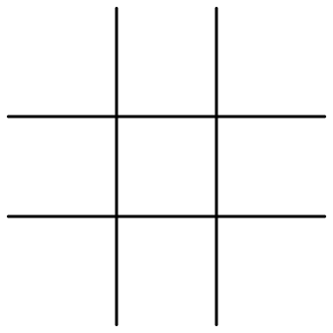
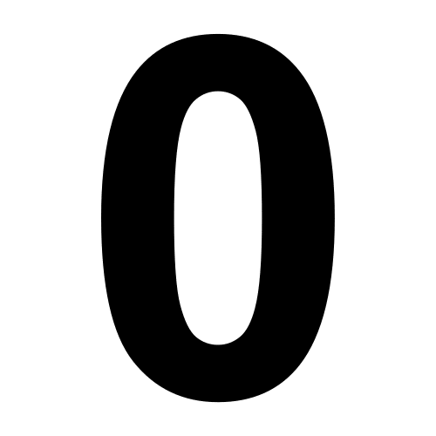
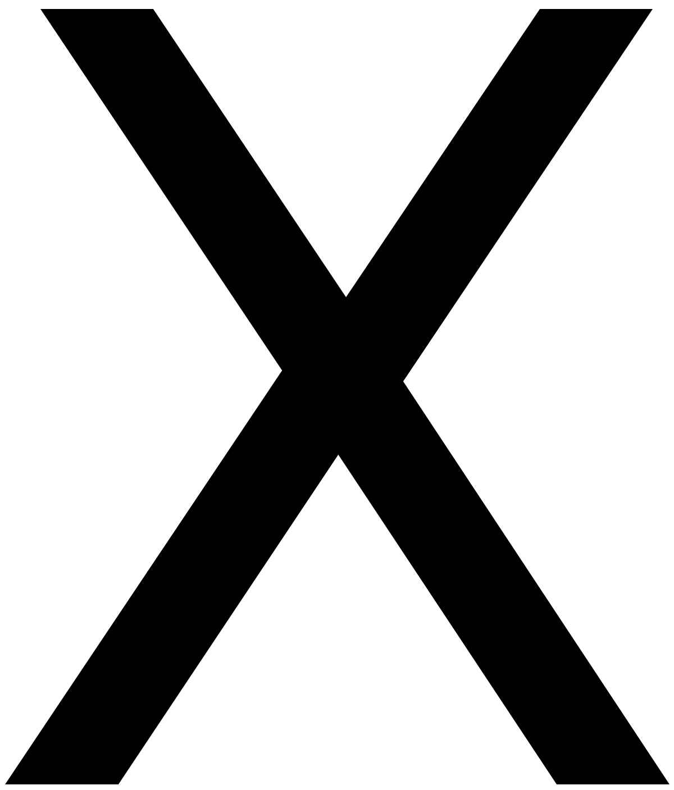
Tic Tac Toe
Noughts win!

Slide 6
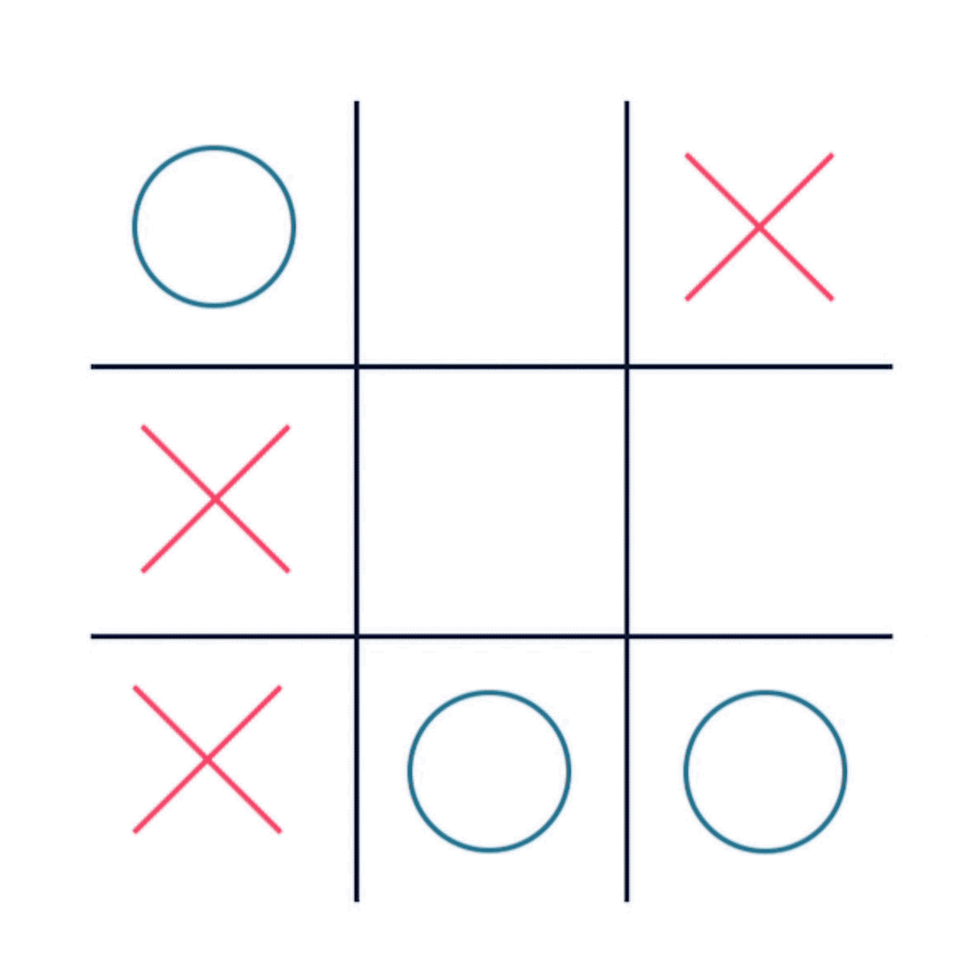
Tic Tac Toe
Tic Tac Toe is a solved game, meaning perfect play is known. Why can Tic Tac Toe be solved?
There are a finite number of possible games of tic tac toe (around 255,168 games)
Let’s design an AI agent that play tic tac toe perfectly

Slide 7
Design Strategy
When designing an AI system, it’s important to design and plan everything before any coding starts
When designing, we need to decompose a high level overview into small achievable tasks. This is known as decomposition
Let’s first adopt a black box, high level overview
What would like our AI to do?
This can be decomposed into thinking about our input and output.
What is our input going to be?
What is our output going to be?

Slide 8
Design
What do want our AI to do?
Input(s) | Output(s)
AI magic
Output(s)
Input(s)

Slide 9
Design
What do want our AI to do? – Play perfect Tic Tac Toe
Input(s) – The Current Board state | Output(s) – The best move
AI magic
The best move
Current Board

Slide 10
Design
Once we known the input and output of the system, we can work on producing an actual implementation (i.e. the black box part).
This idea of decomposition and producing precise system requirements are essential to creating an AI system.
AI magic
The best move
Current Board

Slide 11
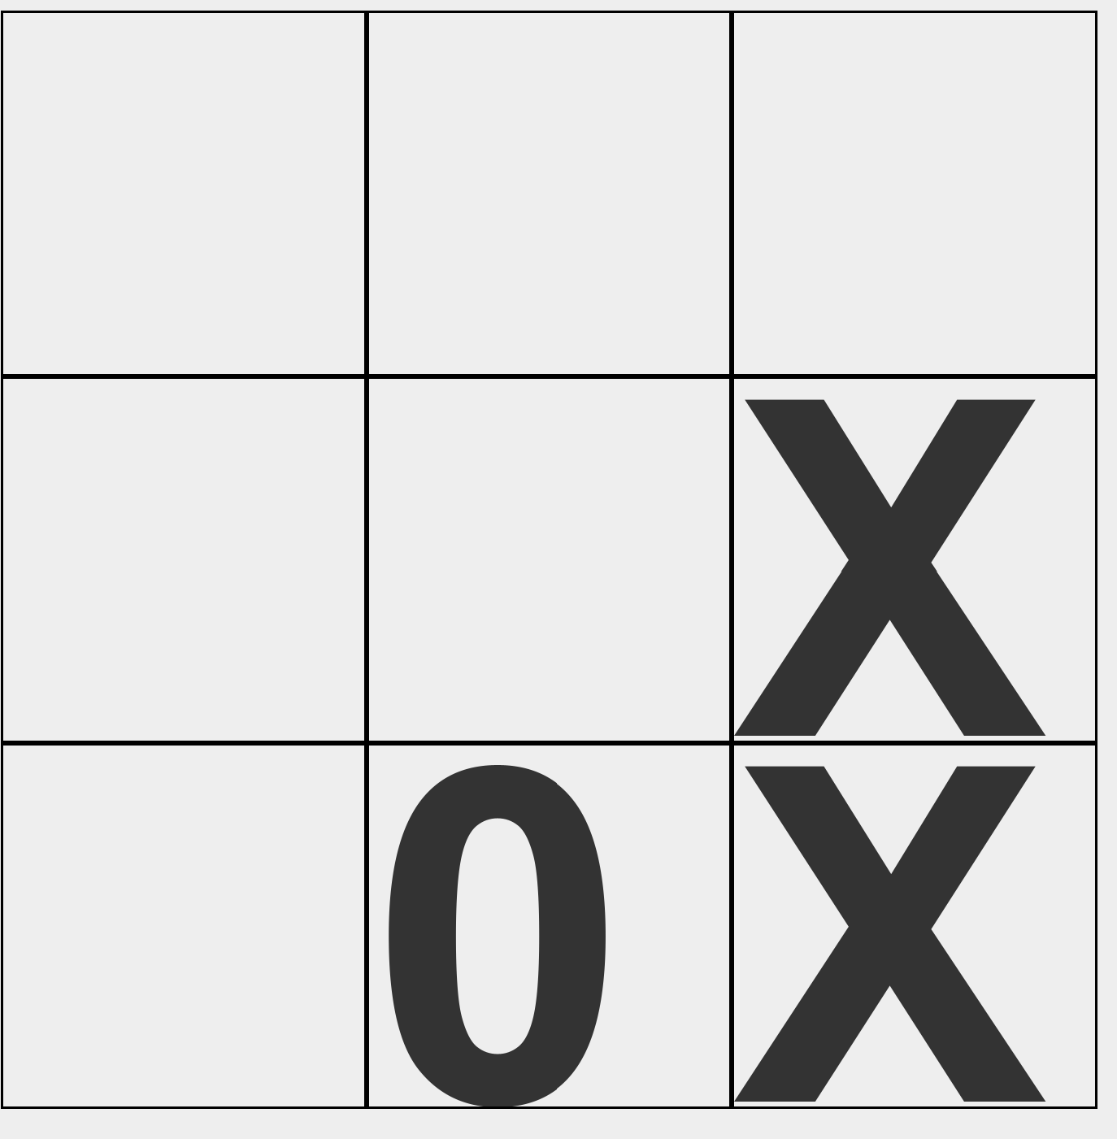
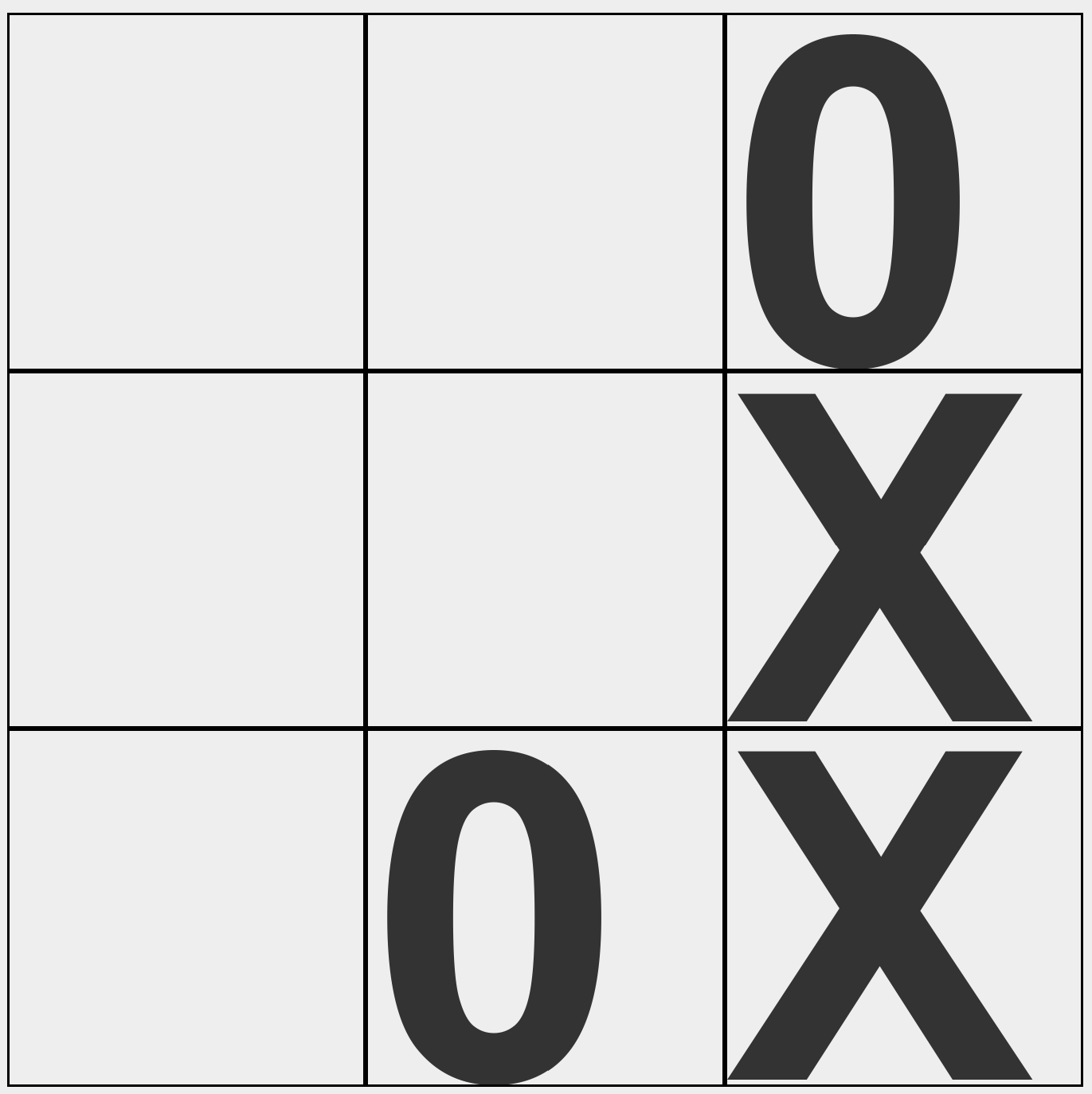
Tic Tac toe
Let’s think about how we would go about playing tic tac toe perfectly? What should we do?
Tic Tac Toe is an example of a system where both sides have all information available to them.
Looking at this position, we know that Noughts has to play in the top right corner to avoid defeat.
Therefore, we know that these two positions are equivalent.
In essence, what we want to do is look at all of our possible moves for a given board. For each of those moves, we need to look at all available moves that our opponent has. Doing this many times will allow us to play perfectly.

Slide 12
Minimax
Tic Tac Toe is an example of an adversarial search.
We already have learned about a range of search algorithms. We are going to use a variation of an algorithm we already have seen to play tic tac toe.
First, we need to understand the game state of tic tac toe. A game can either be won, lost or drawn. For the sake of simplicity “won” = “won by crosses” and “lose” = “lost by crosses”.
Every board state represents some game which will eventually be in one of these states. Thus, we can assign a value to each board based on this.

Slide 13
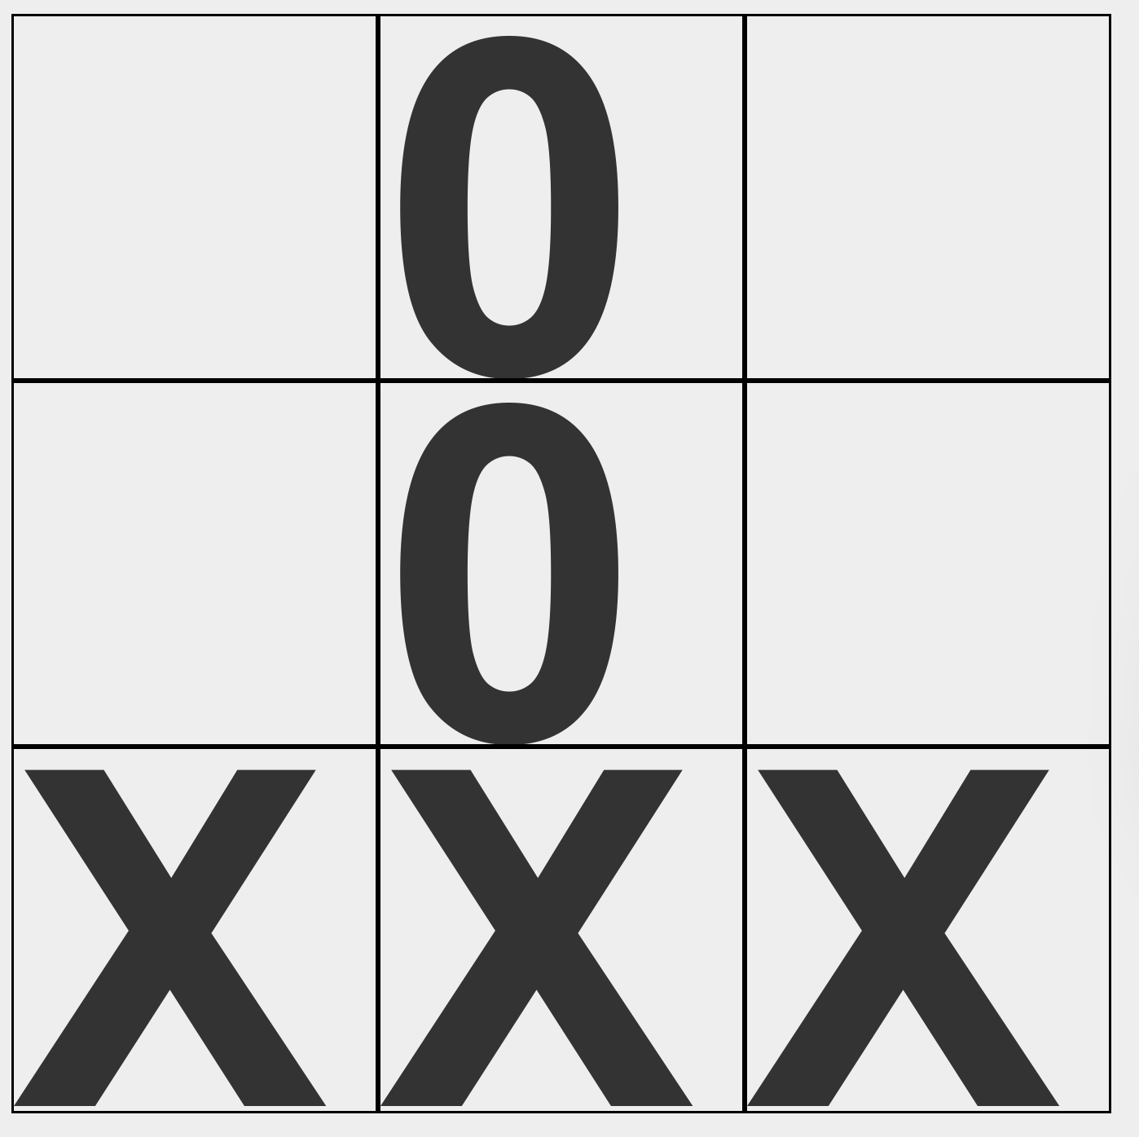
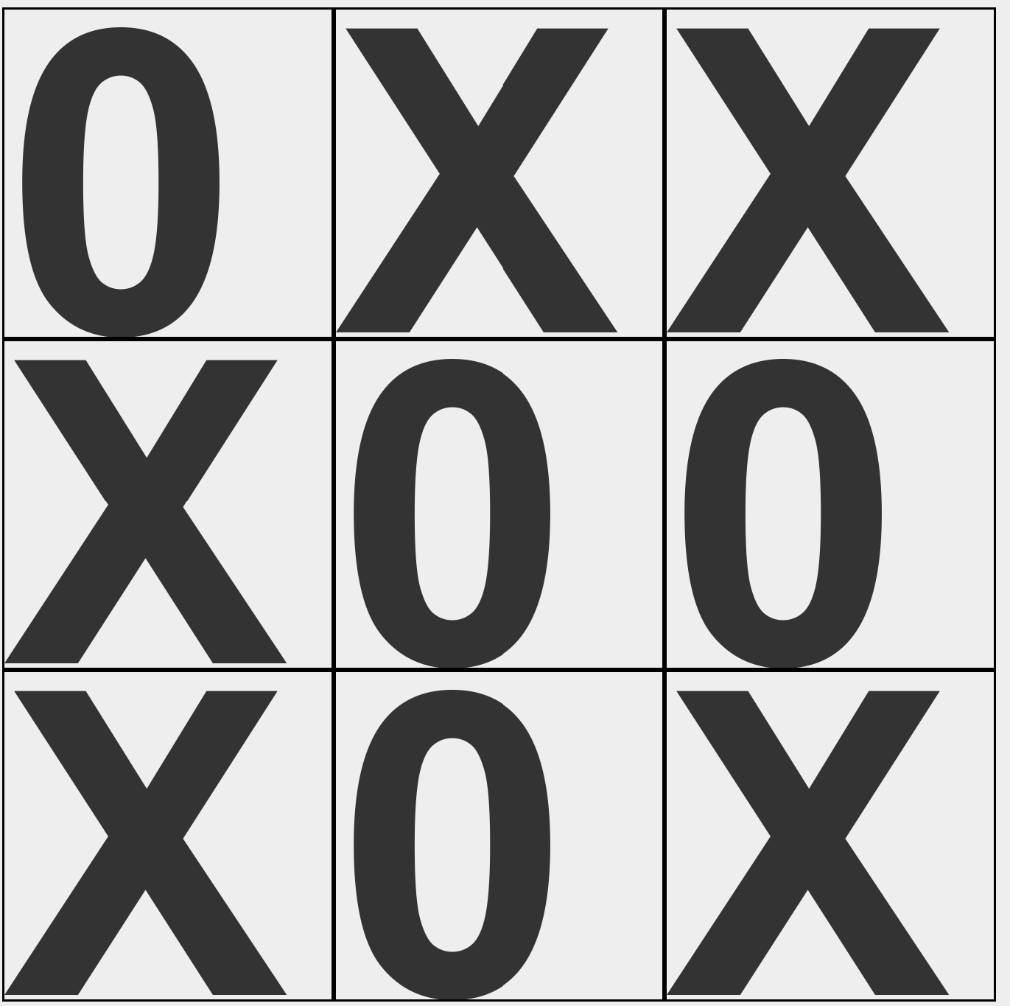
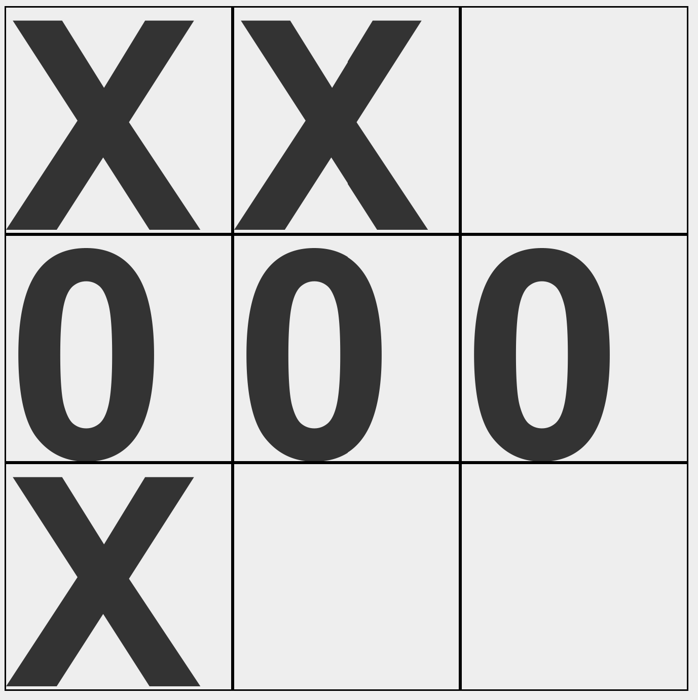
Minimax
+1
0
-1
Lets give each of these three states some numerical representation.
Let’s say a “win” (for crosses) is = 1
A “draw” = 0
A loss = -1

Slide 14
Minimax
Given this new encoding of board states, we know that each board actually has a value of 1, 0 or -1. This means that with perfect play, this is the worst possible outcome for the current player.
So a score of 1, means that if crosses plays perfectly, they will win the game.
This encoding systems helps us formalise what we want to achieve.
When searching, if we are crosses, we want to maximise the value of the board.
If we are noughts, we want to minimise the value of the board.

Slide 15
Board Value
We know that certain positions are either 1, 0 or -1 because the game is over. (Three in a row has been achieved, or no more moves can be made). For these types of positions, we say that the game is in a terminal state.
For non-terminal states, how can we calculate the score?
The answer is an algorithm called minimax. Minimax is an example of a depth first search (DFS).

Slide 16
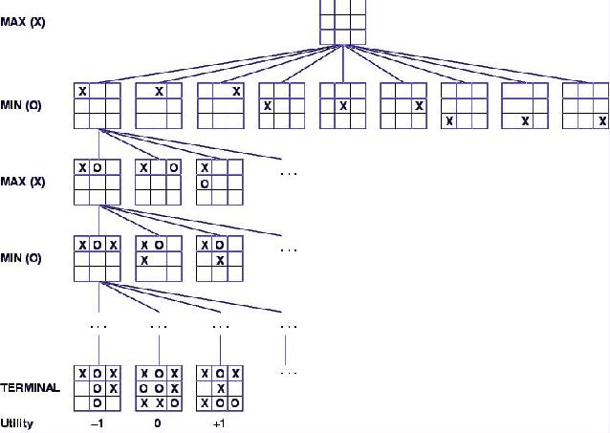
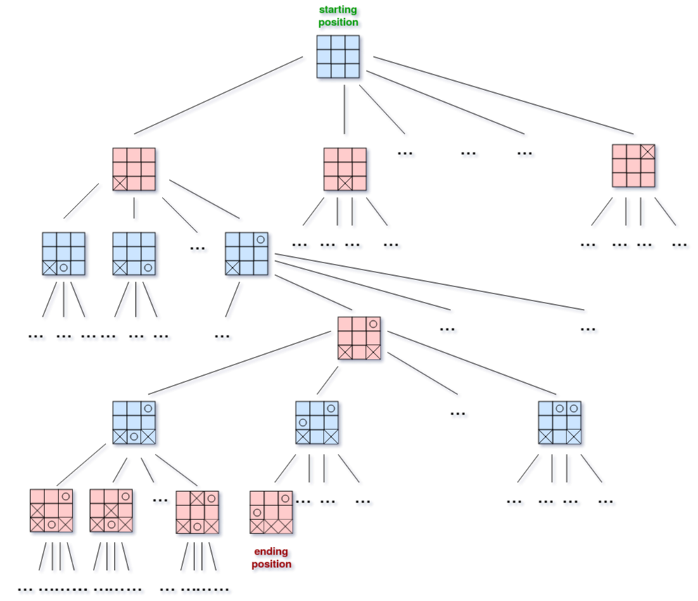
Minimax

Slide 17
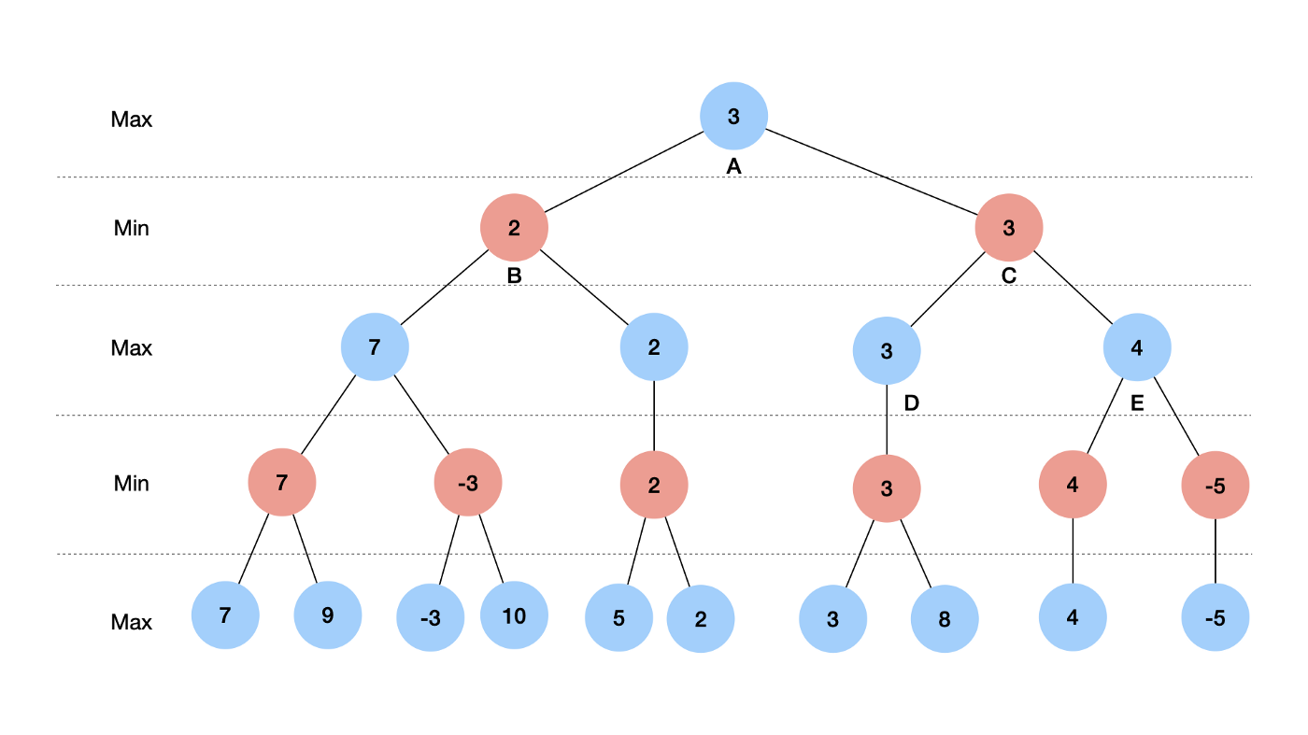
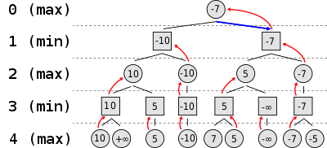
Minimax

Slide 18
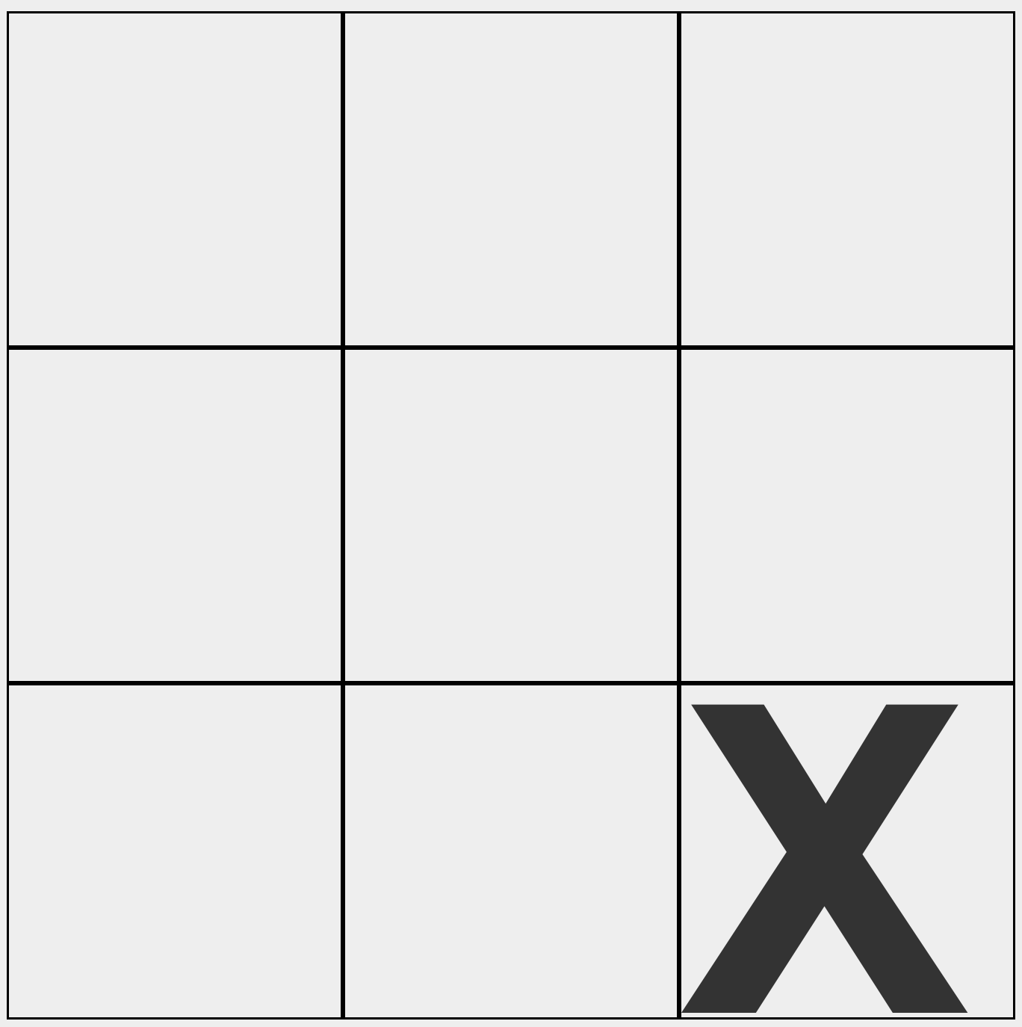
Minimax
The idea is we have two players. One agent is trying to maximise the score (crosses). Noughts is trying to minimise the score.
From the tree we created, we can see how each agent in turn chooses which move to make. They do this by choosing the best move available to them at the time.
The key idea is that for this current state, we can’t actually know how the game will end and thus can’t give the board a score.
We can only score states where three in a row has been reached or the game has ended
Thus we construct a tree of all possible moves from the current board and all possible moves from that.
We only score terminal states, aka. Leaf nodes
We then apply the minimax algorithm to calculate the score of the board

Slide 19
Minimax
Max
Min
Max
Min

Slide 20
Minimax
Max
Min
Max
-1
Min
1
0
1
1
-1
-1
1
Evaluate nodes at terminal state

Slide 21
Minimax
Max
Min
Max
?
-1
Min
1
0
1
1
-1
-1
1

Slide 22
Minimax
Max
Min
Max
1
-1
Min
1
0
1
1
-1
-1
1

Slide 23
Minimax
Max
Min
Max
1
?
-1
Min
1
0
1
1
-1
-1
1

Slide 24
Minimax
Max
Min
Max
1
1
-1
Min
1
0
1
1
-1
-1
1

Slide 25
Minimax
Max
Min
?
Max
1
1
-1
Min
1
0
1
1
-1
-1
1

Slide 26
Minimax
Max
Min
-1
Max
1
1
-1
Min
1
0
1
1
-1
-1
1

Slide 27
Minimax
Max
Min
-1
Max
1
1
?
-1
Min
1
0
1
1
-1
-1
1

Slide 28
Minimax
Max
Min
-1
Max
1
1
-1
-1
Min
1
0
1
1
-1
-1
1

Slide 29
Minimax
Max
Min
-1
Max
1
1
-1
?
-1
Min
1
0
1
1
-1
-1
1

Slide 30
Minimax
Max
Min
-1
Max
1
1
-1
1
-1
Min
1
0
1
1
-1
-1
1

Slide 31
Minimax
Max
Min
?
-1
Max
1
1
-1
1
-1
Min
1
0
1
1
-1
-1
1

Slide 32
Minimax
Max
Min
-1
-1
Max
1
1
-1
1
-1
Min
1
0
1
1
-1
-1
1

Slide 33
Minimax
Max
?
Min
-1
-1
Max
1
1
-1
1
-1
Min
1
0
1
1
-1
-1
1

Slide 34
Minimax
Max
-1
Min
-1
-1
Max
1
1
-1
1
-1
Min
1
0
1
1
-1
-1
1

Slide 35
Minimax
Max
-1
Min
-1
-1
Max
1
1
-1
1
-1
Min
1
0
1
1
-1
-1
1
Thus, we can now say that the value of the current board state is -1
This means that, with perfect play, crosses is guaranteed to lose. (I.e.), noughts are guaranteed to win.

Slide 36
Minimax
Max
-1
Min
-1
-1
Max
1
1
-1
1
-1
Min
1
0
1
1
-1
-1
1
Notice, how we only evaluate nodes at the bottom of the tree initially. This makes minimax a depth-first search.
However, notice that we explore that entire tree, thus guaranteeing us optimality. This also makes it an instance of breadth-first search.

Slide 37
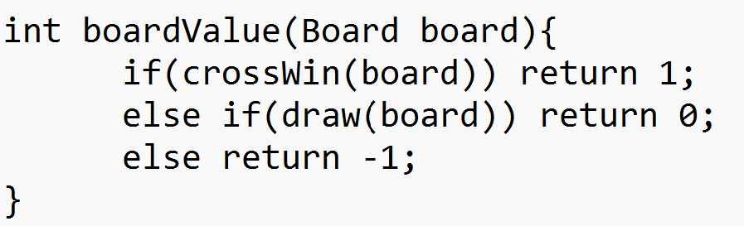
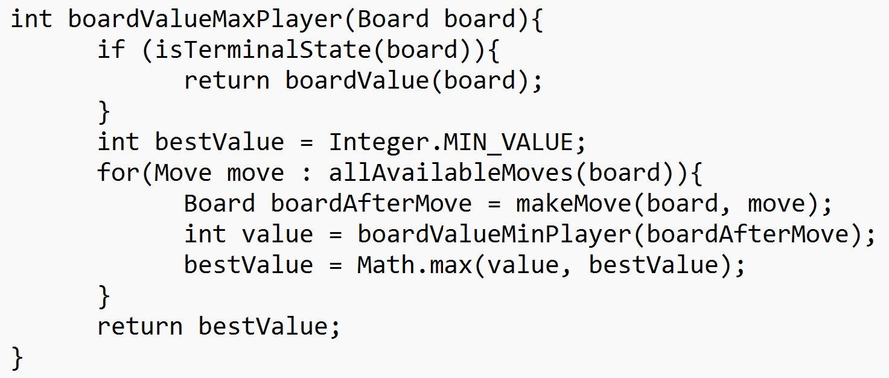
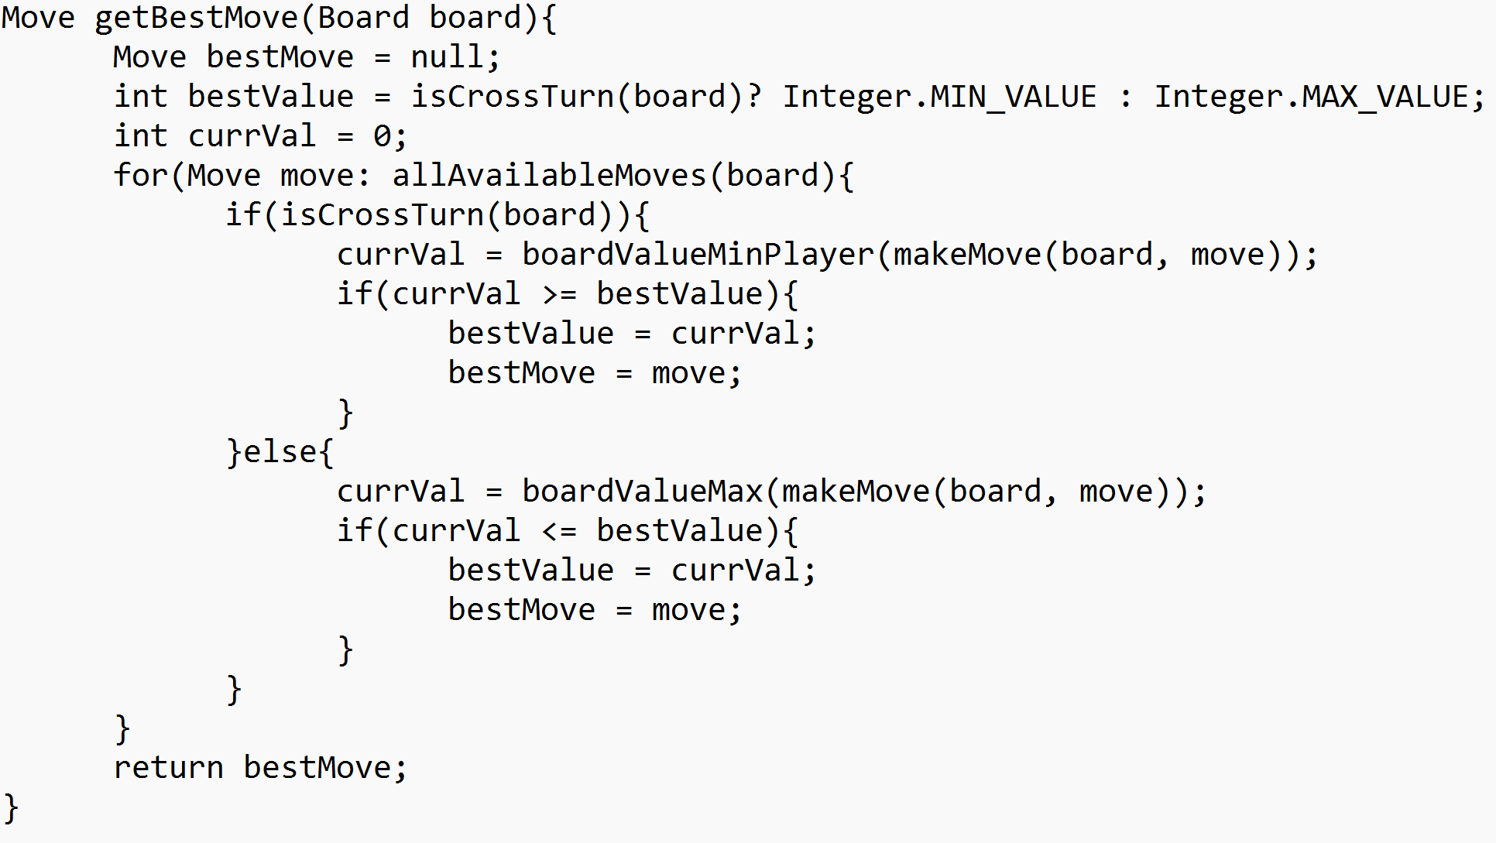
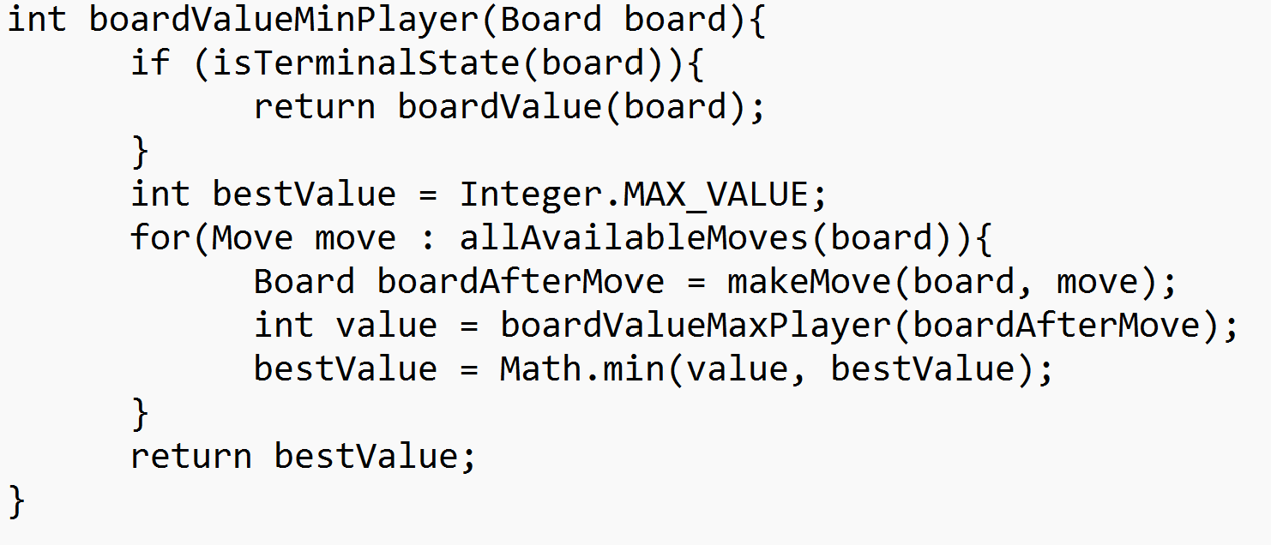
Minimax

Slide 38
Minimax
This algorithm explores all of the possible game states that could occur after the current one
This guarantees that the best possible move is found
Using this, we have now created a perfect tic tac toe playing AI. It will never lose at the game!
We’ve now completed our design
Minimax search
The best move
Current Board

Slide 39
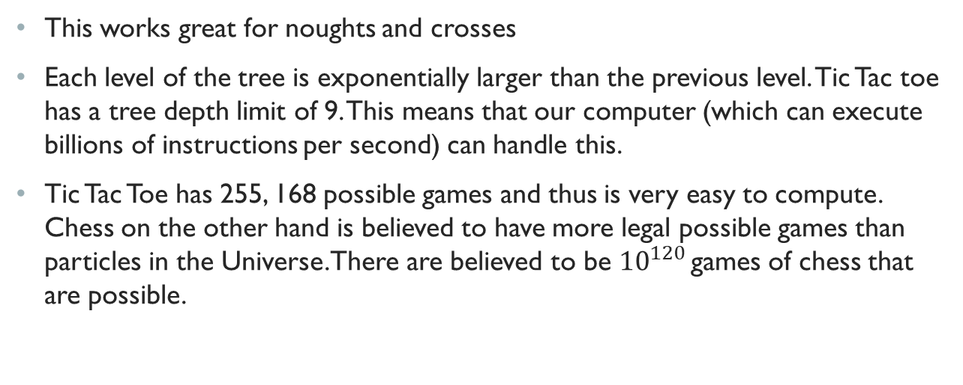
Design Limitations
This works great for noughts and crosses
Each level of the tree is exponentially larger than the previous level. Tic Tac toe has a tree depth limit of 9. This means that our computer (which can execute billions of instructions per second) can handle this.
Tic Tac Toe has 255, 168 possible games and thus is very easy to compute. Chess on the other hand is believed to have more legal possible games than particles in the Universe. There are believed to be ${10}^{120}$ games of chess that are possible.

Slide 40

$${10}^{120}$$
1000000000000000000000000000000000000000000000000000000000000000000000000000000000000000000000000000000000000000000000000 games of chess!
Clearly no computer can handle this. Hence, we need to adapt our algorithm to be more domain generalisable.
In many cases, there may be a series of moves that lead to the same position (or a symmetric position), these can be cached and accessed when needed.
However, with clever pruning, we can avoid looking at every possible board state. This is known as alpha-beta pruning.

Slide 41
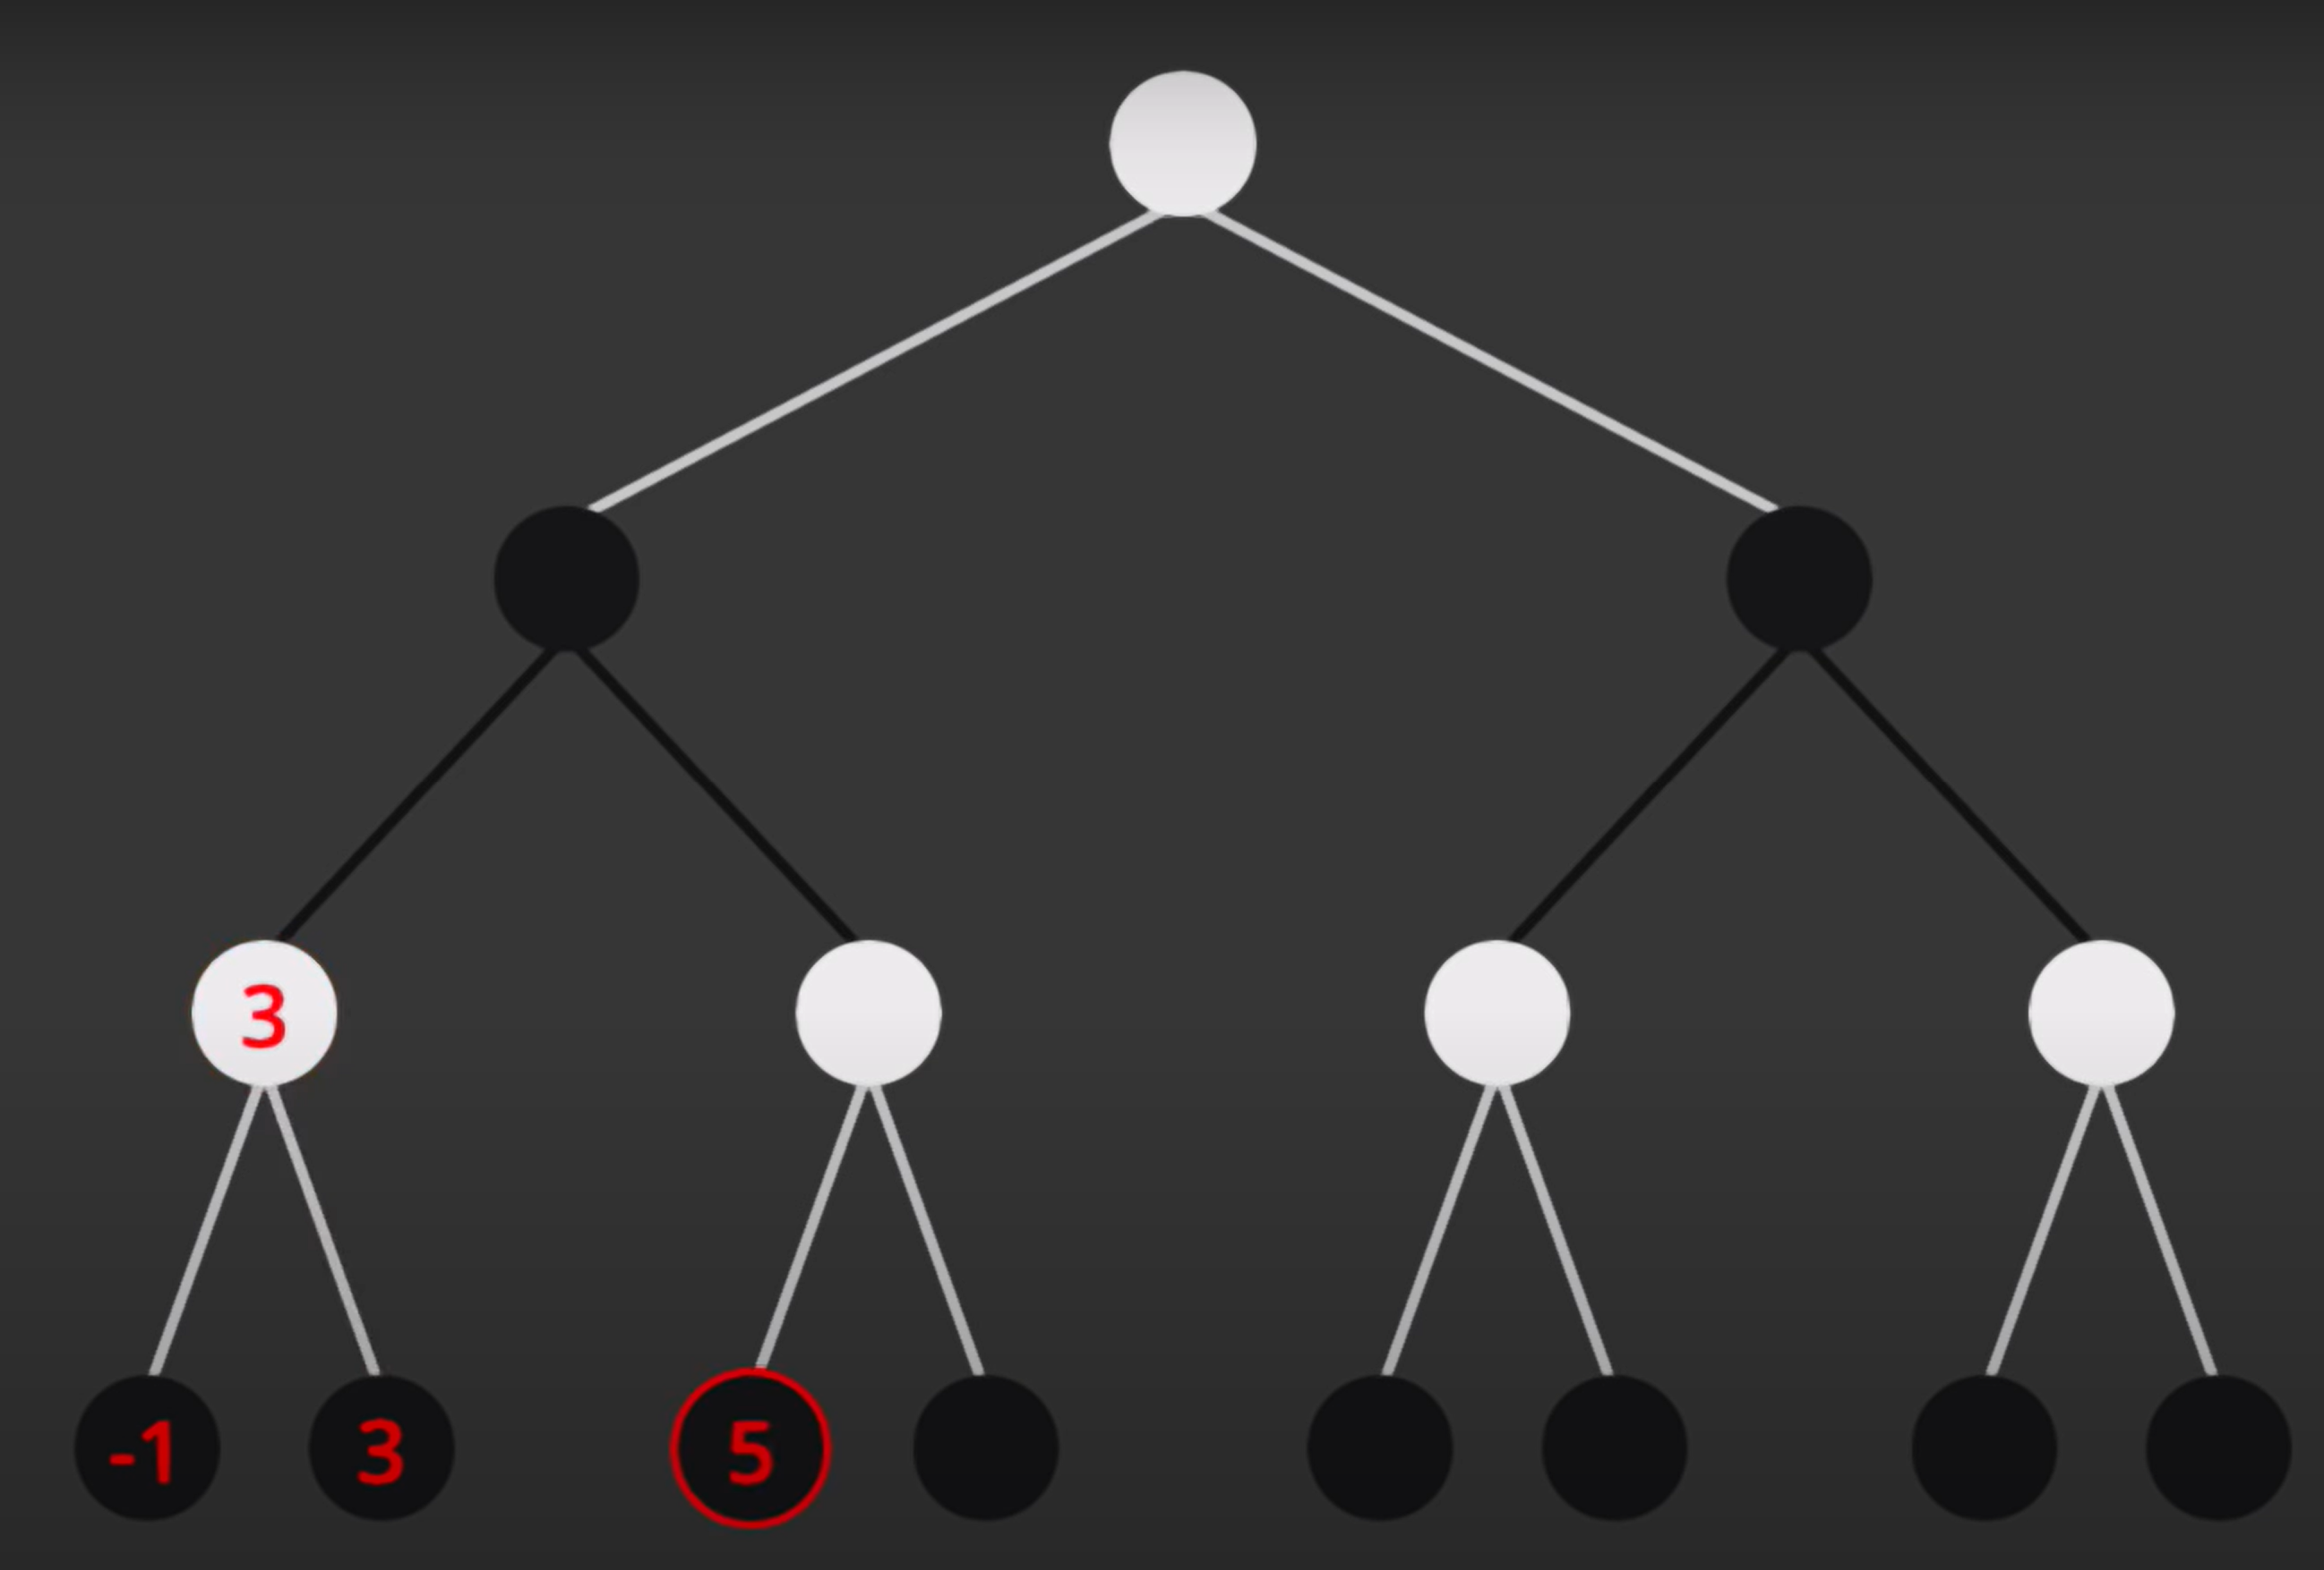
Alpha-Beta Pruning
Credit: Sebastian Lague https://youtu.be/l-hh51ncgDI
Max
Min
Max
Min

Slide 42
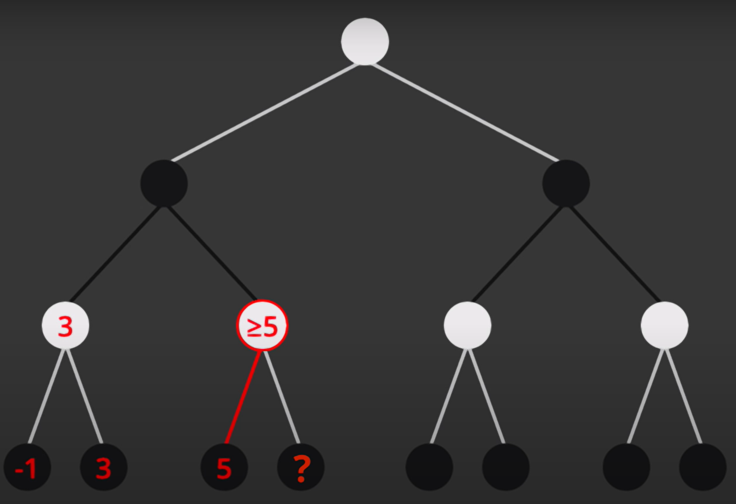
Alpha-Beta Pruning
Credit: Sebastian Lague https://youtu.be/l-hh51ncgDI
Max
Min
Max
Min

Slide 43
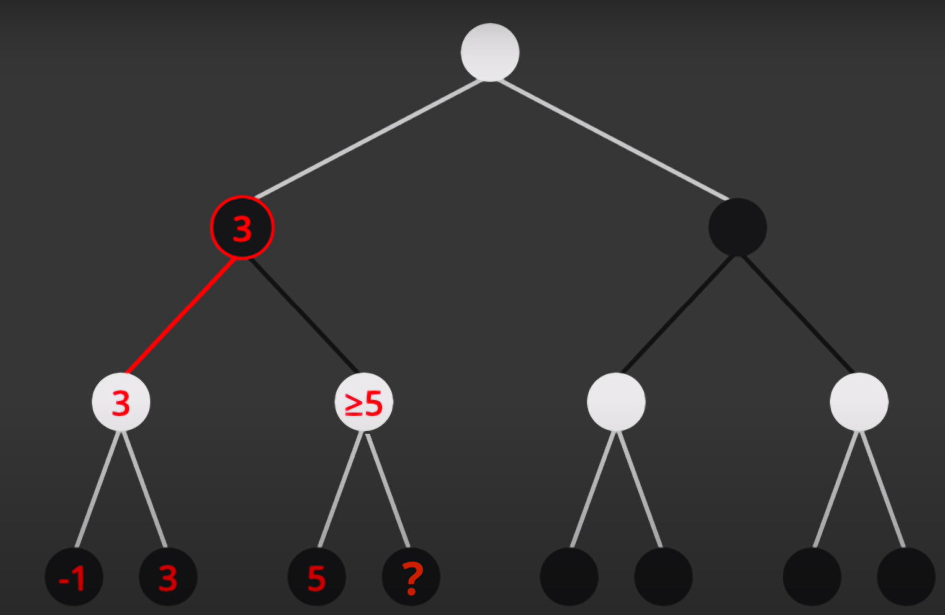
Alpha-Beta Pruning
Credit: Sebastian Lague https://youtu.be/l-hh51ncgDI
Max
Min
Max
Min

Slide 44
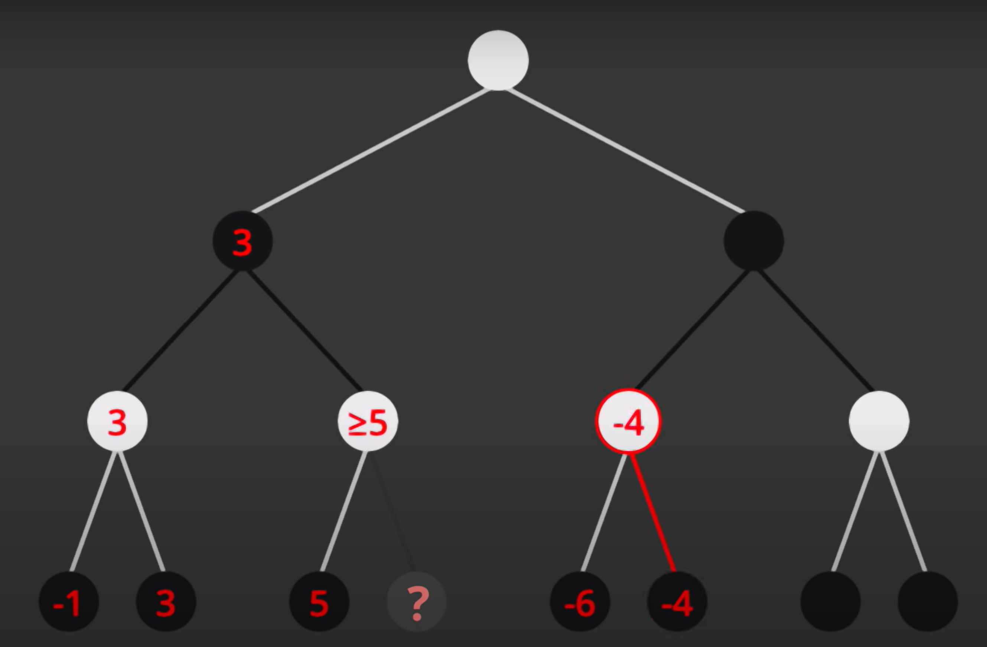
Alpha-Beta Pruning
Credit: Sebastian Lague https://youtu.be/l-hh51ncgDI
Max
Min
Max
Min

Slide 45
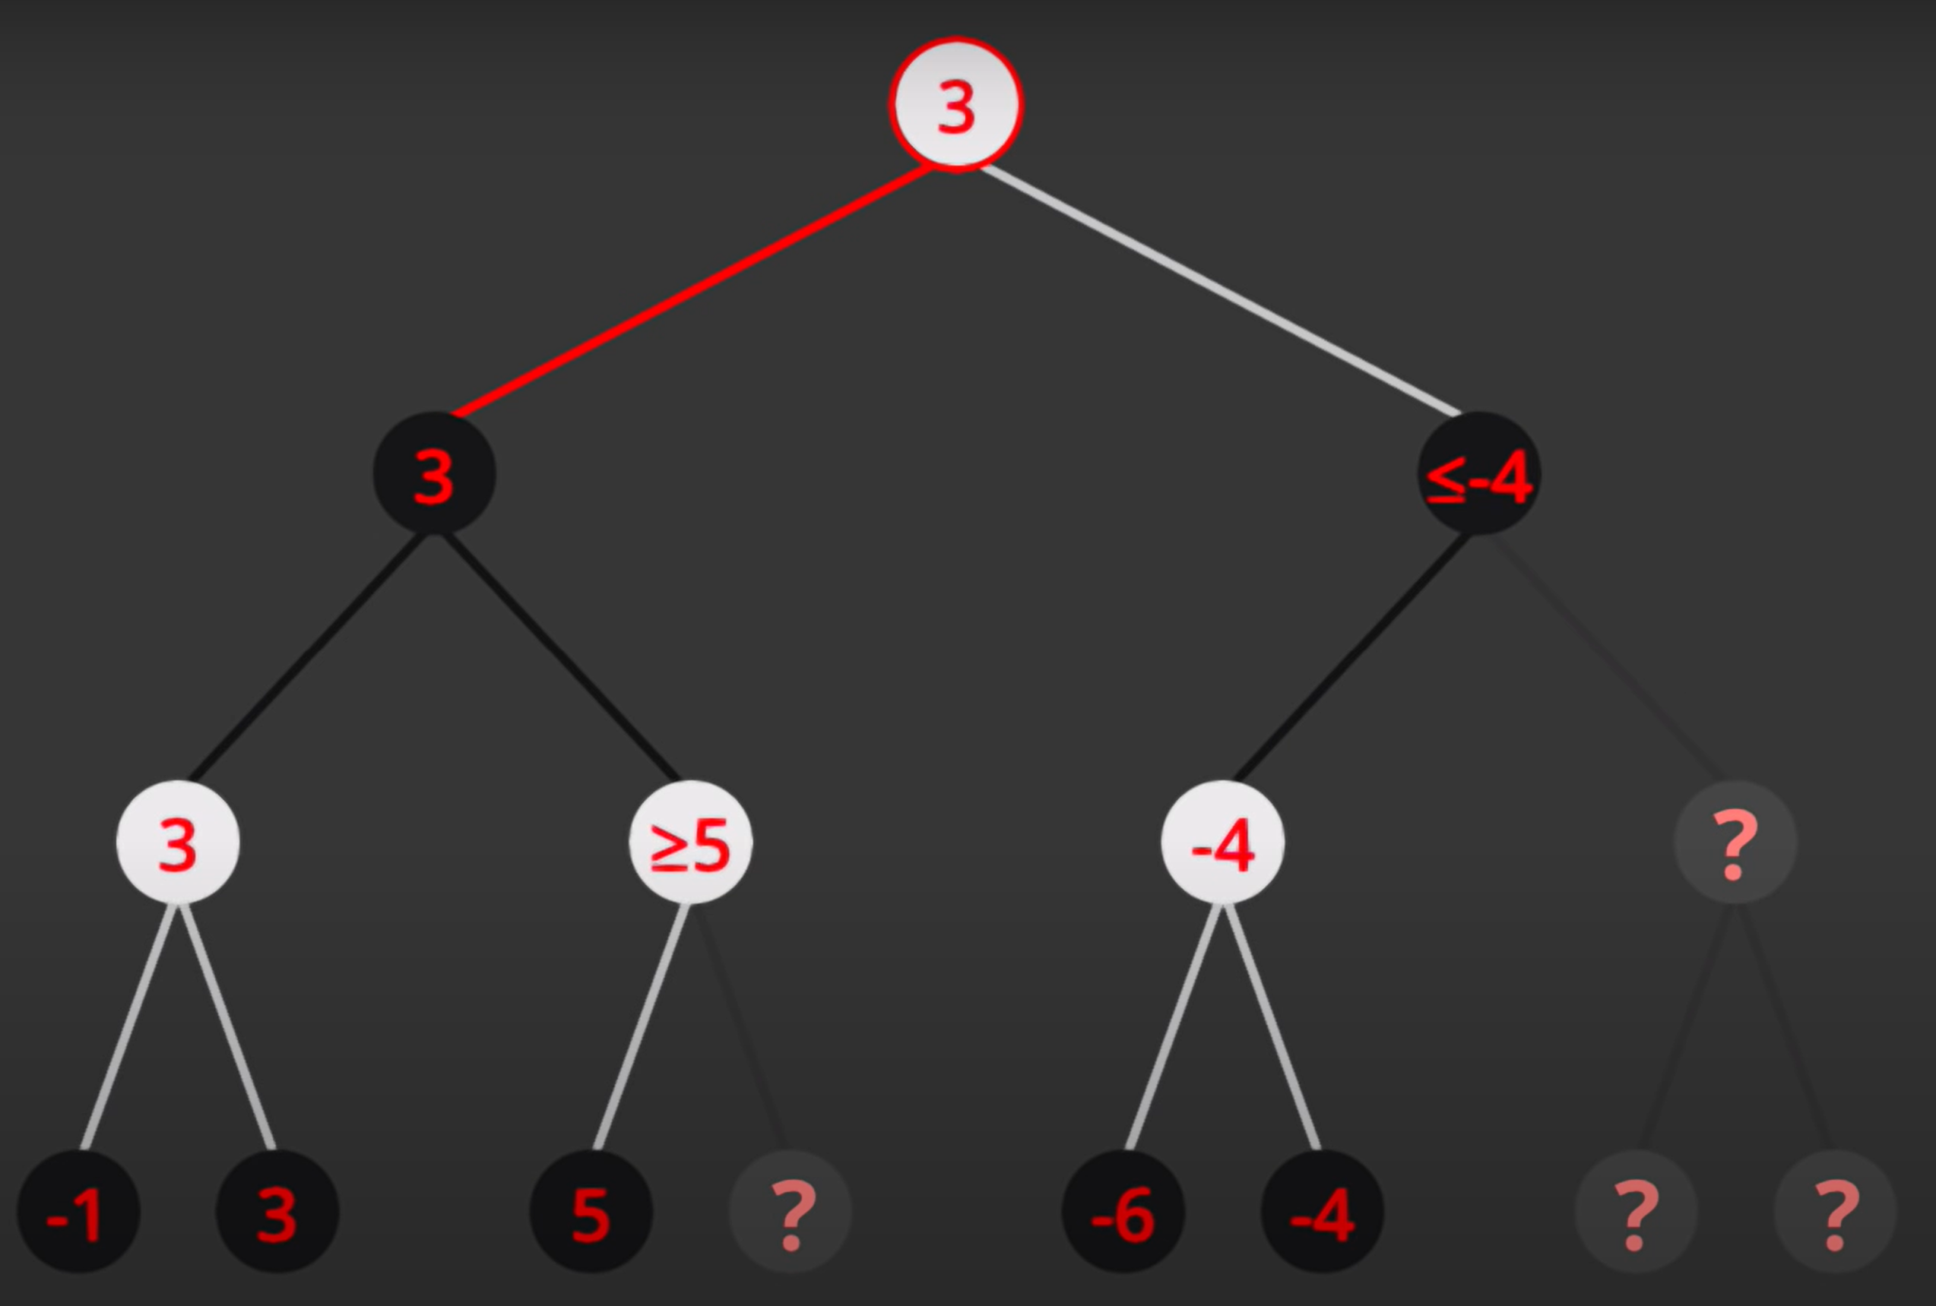
Alpha-Beta Pruning
Credit: Sebastian Lague https://youtu.be/l-hh51ncgDI
Max
Min
Max
Min

Slide 46
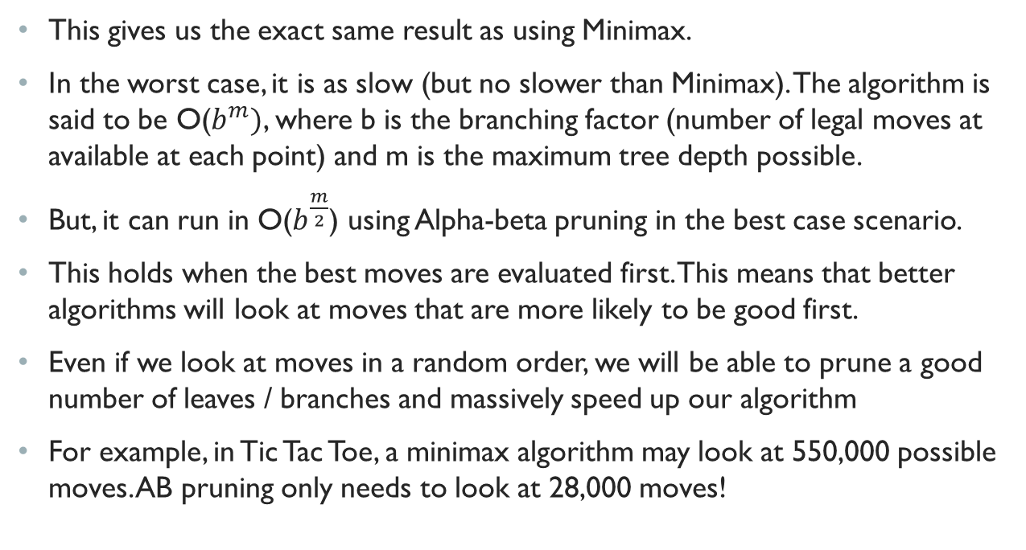
Alpha-Beta Pruning
This gives us the exact same result as using Minimax.
In the worst case, it is as slow (but no slower than Minimax). The algorithm is said to be O($b^{m})$, where b is the branching factor (number of legal moves at available at each point) and m is the maximum tree depth possible.
But, it can run in O($b^{\frac{m}{2}}$) using Alpha-beta pruning in the best case scenario.
This holds when the best moves are evaluated first. This means that better algorithms will look at moves that are more likely to be good first.
Even if we look at moves in a random order, we will be able to prune a good number of leaves / branches and massively speed up our algorithm
For example, in Tic Tac Toe, a minimax algorithm may look at 550,000 possible moves. AB pruning only needs to look at 28,000 moves!

Slide 47
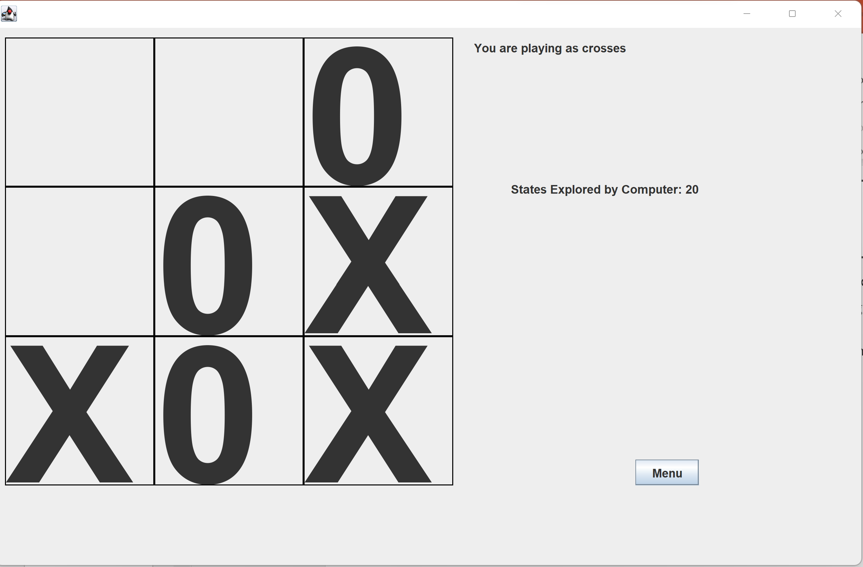
Tic Tac Toe
I implemented minimax and minimax + alpha-beta pruning in Tic Tac Toe.
Code walkthrough! – To view source code, follow the following link: https://github.com/philipmortimer/TicTacToe-Minimax-Java
Let’s fix any technical issues + look through source code together.
Let’s play tic tac toe!

Slide 48
States Explored (Rough)
 | Move #1 | Move #2 | Move #3 | Move #4 | Move #5 | Move #6 | Move #7 | Move #8 | Move #9
Minimax | 549, 945 | 59, 704 | 7, 331 | 934 | 197 | 46 | 13 | 4 | 1
AB prune | 27, 565 | 4, 676 | 2, 346 | 525 | 96 | 43 | 13 | 4 | 1
Note, that this AB number could be significantly smaller (my implementation is not particularly efficient).

Slide 49
States Explored (Rough)
 | Move #1 | Move #2 | Move #3 | Move #4 | Move #5 | Move #6 | Move #7 | Move #8 | Move #9
Minimax | 549, 945 | 59, 704 | 7, 331 | 934 | 197 | 46 | 13 | 4 | 1
AB prune | 27, 565 | 4, 676 | 2, 346 | 525 | 96 | 43 | 13 | 4 | 1

Slide 50
Depth Limited Minimax
Even with Alpha-Beta pruning, the number of states grows exponentially. This means that games that have more than 9 possible moves quickly become impossible to solve.
Thus we typically limit how many moves ahead into the future our system is allowed to search. For example, in chess, we might say that we are only allowed to look a maximum of 7 seven moves into the future. A computer may run the AB calculation in a fraction of a second. But if we look 12 moves into the future, me way wait years for the result.
For tic tac toe, we said we would only evaluate board states that are terminal. If we limit our search depth, we can’t guarantee that our board state is terminal.
Thus, we need a heuristic to estimate which player is winning. For example, we may want to see which player currently has more pieces (in chess) to see whether white or black is winning. We use this heuristic value on the tree instead.

Slide 51
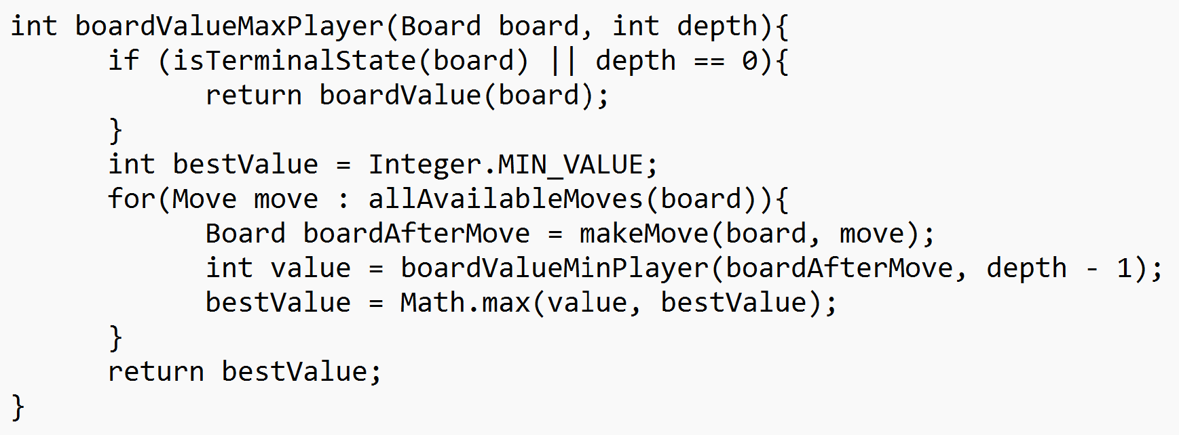
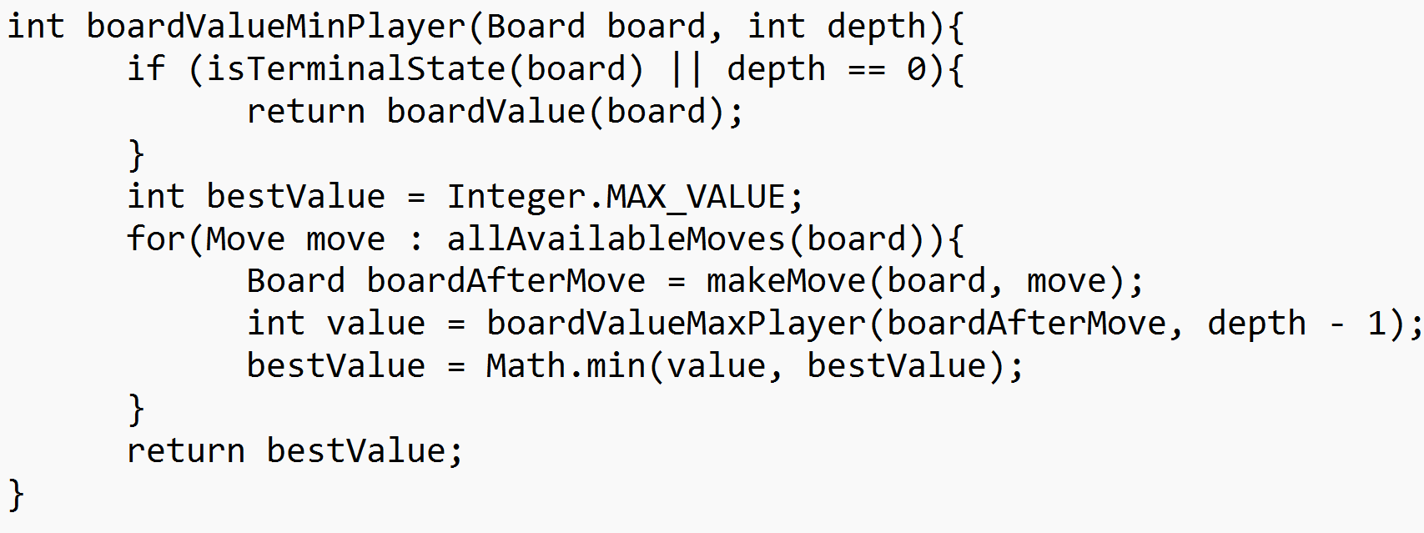
Depth Limited Minimax
Top AI systems use a depth limited minimax search that implements Alpha-beta pruning. Implementation of a depth limit is fairly easy, we can simply amend our current pseudocode slightly.

Slide 52
Alpha–Beta Pruning
Let’s formalise our reasoning behind AB pruning into code.
At every call in the tree, we will have values to keep track of: alpha and beta.
Alpha represents the value that the maximising players is guaranteed to achieve for the current search level or above.
Beta represents the value that the minimising player is guaranteed to achieve for the current level or above.
If it’s the maximisers turn, they update the alpha value if they discover a move that leads to a higher score than the current alpha.
If it’s the maximisers turn, and alpha exceeds or is equal to beta, pruning occurs. This is because the minimising player will never choose a branch higher than beta (as they are already guaranteed beta as a worst-case).
Similar logic applies to the minimiser turn.

Slide 53
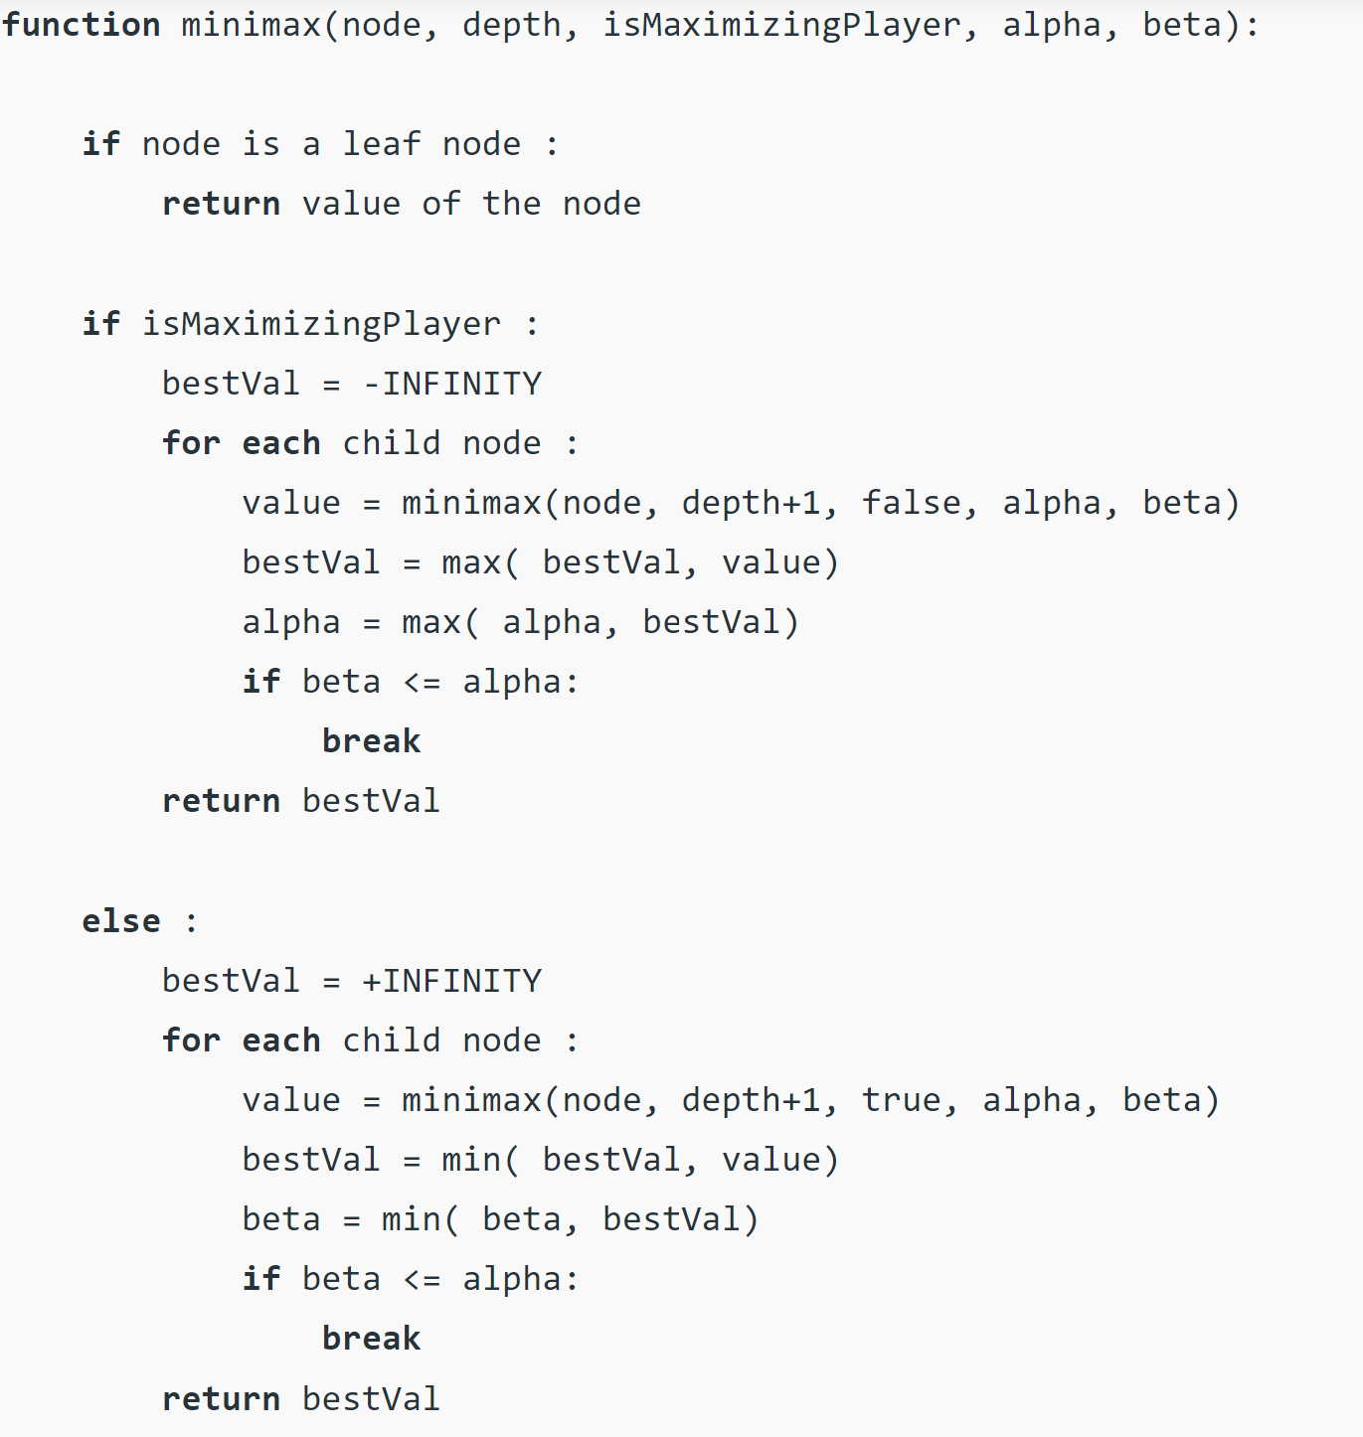
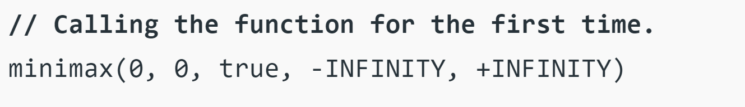
AB Pruning
Credit: GeeksForGeeks https://www.geeksforgeeks.org/minimax-algorithm-in-game-theory-set-4-alpha-beta-pruning/

Slide 54
Minimax
We have now formalised an algorithm that can be applied to a whole range of adversarial search problems (including two player board games).
We look at all possible moves up to a specific amount of time in the future. We then apply some heuristic that estimates the value of the board state at this point. We then use the Minimax algorithm (a depth-first search algorithm) to determine what the best move is. Alpha-beta pruning is used to search this space more efficiently.
With small modifications, this can be applied to other domains outside of just two player games where both sides have all (or some) information accessible.

Slide 55
Iterative Deepening
The problem with depth-limited minimax is that we must manually select how deep our computer should search.
Different computers will be more / less powerful and hence different search depths will be needed.
Often, we actually want to limit our search by time
We can adapt our minimax algorithm so that it only searches for a given period of time
This is widely used in games like chess, where time limits are implemented
To achieve this, we use an algorithm known as iterative deepening

Slide 56
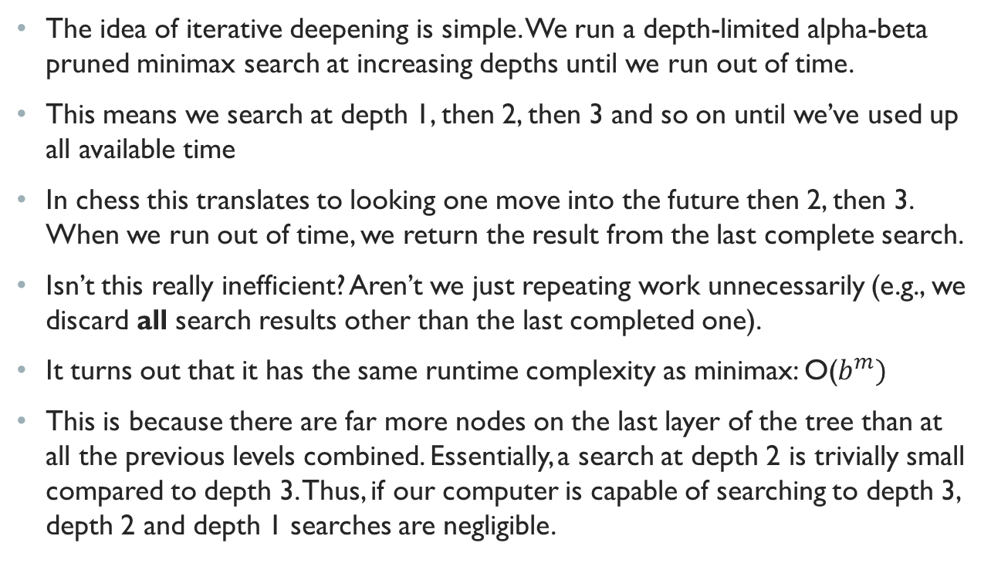
Iterative Deepening
The idea of iterative deepening is simple. We run a depth-limited alpha-beta pruned minimax search at increasing depths until we run out of time.
This means we search at depth 1, then 2, then 3 and so on until we’ve used up all available time
In chess this translates to looking one move into the future then 2, then 3. When we run out of time, we return the result from the last complete search.
Isn’t this really inefficient? Aren’t we just repeating work unnecessarily (e.g., we discard all search results other than the last completed one).
It turns out that it has the same runtime complexity as minimax: O($b^{m})$
This is because there are far more nodes on the last layer of the tree than at all the previous levels combined. Essentially, a search at depth 2 is trivially small compared to depth 3. Thus, if our computer is capable of searching to depth 3, depth 2 and depth 1 searches are negligible.

Slide 57
Iterative Deepening
Remember, they key to an efficient algorithm is move ordering. The best moves should be expanded first in order to maximise alpha-beta pruning efficiency
Iterative deepening will give us the best moves at depth of 1. Often, this will be the best (or one of the best moves) at depth 2 as well. Hence, if we store the result from our previous depth search and expand this first, we are likely to cut-off a much larger portion of the search tree.
Hence, iterative deepening is often a far more efficient (and faster) than minimax + alpha beta pruning. Essentially iterative deepening allows us to look further ahead into the future, for the same computation cost. This is why it is used in the top chess engines.

Slide 58
Summary
Minimax is an algorithm that allows us to perform an adversarial search
Discussed how it can be applied to board games to achieve perfect / high-level play.
Alpha-beta pruning is an optimisation that drastically speeds up the minimax algorithm whilst still producing the same result. It is fastest when moves are ordered from best to worst (although even a random ordering will lead to massive speedups)
Discussed how depth-limits are needed to for most board games as search space is incredibly large.
Heuristics are used to estimate a given board state at nodes at the specified depth-limit.
Iterative deepening allows AI agents to search for a given period of time, and allows for deeper searches than using a fixed depth in the same amount of time.

Slide 59

Questions

Slide 60
Further Reading
Minimax: https://towardsdatascience.com/how-a-chess-playing-computer-thinks-about-its-next-move-8f028bd0e7b1
Minimax + AB-pruning + depth limit: https://www.youtube.com/watch?v=l-hh51ncgDI https://www.cs.cornell.edu/courses/cs312/2002sp/lectures/rec21.htm
Iterative deepening: https://www.chessprogramming.org/Iterative_Deepening
Heuristics (evaluation function): https://www.chessprogramming.org/Evaluation

